Slide 1
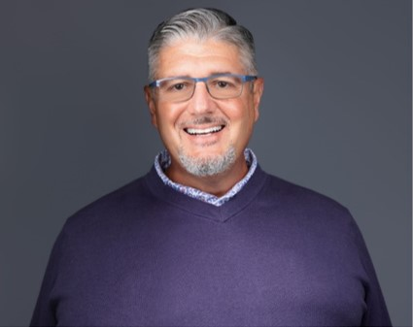
I joined the Florida College System Risk Management Consortium (FCSRMC) in 2002 and have served as Executive Director and Chief Risk Officer since 2007. FCSRMC delivers innovative enterprise-wide risk management to support the 28 colleges of the Florida College System, which has 50,000 employees, 800,000 students, and $9.6 billion in property. Prior to joining FCSRMC, I worked in the financial sector and in specialty retail management.
I am an active member of the Florida Education Risk Manager Association (FERMA), the Risk Insurance Society (RIMS), and URMIA through a range of activities, which include sharing my expertise, conference planning, and governance. I am especially proud to have served as president of URMIA for an extended term from 2019-2021 during the COVID-19 pandemic, and continue to serve on the URMIA board as immediate past-president. Outside of work, I am a lifelong swimmer and wine enthusiast.
Education
University of Florida, Gainesville, Florida, Bachelor of Science – Advertising
Chauncey Fagler, ARM-P
Executive Director & Chief Risk Officer
Contact Information
Phone: 352-955-2190 ext. 101
Email: cfagler@fcsrmc.com
Website: www.fcsrmc.com
Office Address
4500 NW 27th Avenue
Suite B2
Gainesville, FL 32606

