Slide 1
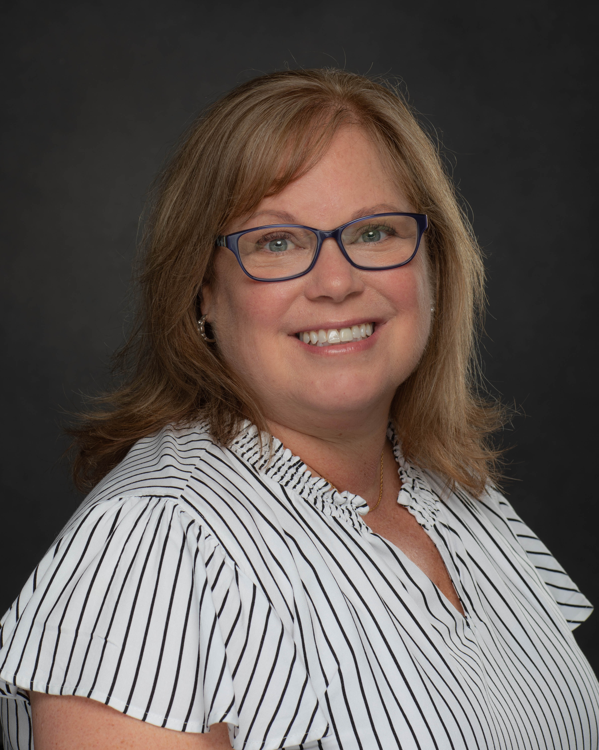
I joined the Florida College System Risk Management Consortium (FCSRMC) in 2015 and serve as an Enterprise Risk Manager. FCSRMC is a risk management Consortium created by the legislature to support insurance and risk management needs of the 28 colleges of the Florida College System. My experience prior to joining FCSRMC is on the insurance brokerage side of the insurance industry specializing in commercial risks and K-12 school districts.
I am an active member of the Florida Education Risk Manager Association (FERMA), the Risk Insurance Society (RIMS), and University Risk Management & Insurance Association (URMIA). I enjoy volunteering with Girl Scouts and supporting my Daughter’s extra-curricular activities.
Education
Santa Fe College, Gainesville, Florida, Bachelor of Science – Organizational Management
Marsha Hackathorn ARM-P
Enterprise Risk Manager
Contact Information
Phone: 352-955-2190 ext. 112
Email: mhackathorn@fcsrmc.com
Website: www.fcsrmc.com
Office Address
4500 NW 27th Avenue
Suite B2
Gainesville, FL 32606

